Slide 1
Sprint #9
Team Members
Brandon Tu, Affan Khan, Himmat Mahal , Chris Fitzgerald, Mussab Bin Imran , and Ibrahim Rather

Slide 2
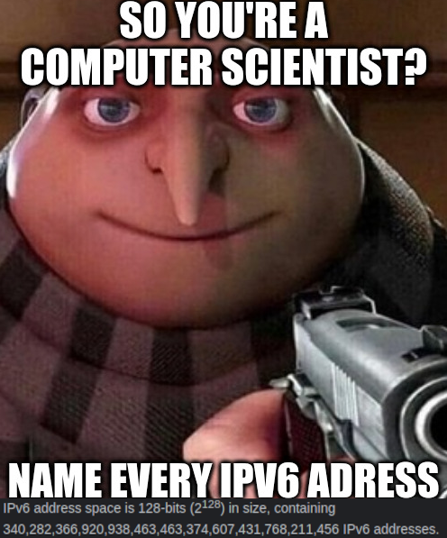
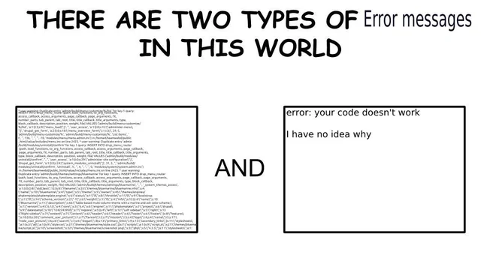

Slide 3
What went well
We have consistently efficient meetings
Short, but many issues are created/assigned
We had ideas for new tasks from the last sprint
This led to features with more thought behind them

Slide 4
Things to improve on
Working on things sooner
Not being sick

Slide 5
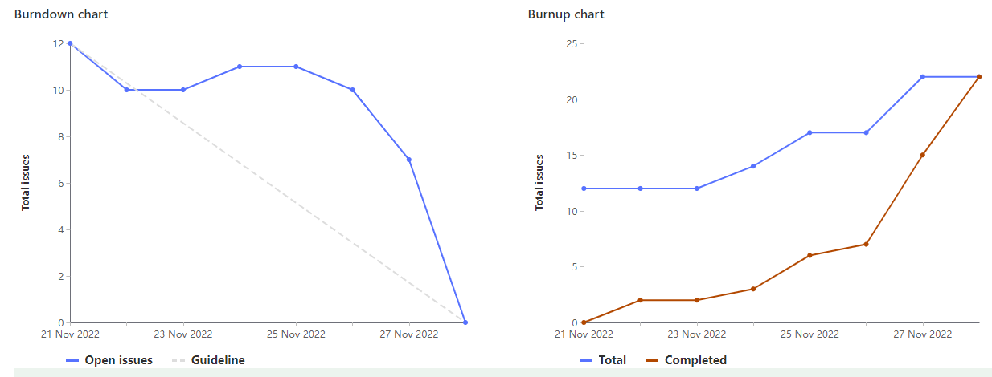
Burndown & Burnup chart(s)

Slide 6
Sprint 9 Highlights - Brandon Tu (1047332)
(3) Creating the functionality for saving and loading courses
(2) Having each course have a link to their u of g description page
(3) Clear suggested courses functionality
Total: ~20

Slide 7
Sprint 9 highlight - Mussab Bin Imran (1111908)
Updated the UI of the website to make it look more appealing (3)
Made a legend to help read the schedule (4)
Modified the alert box to show additional info about the conflicting courses (4)
Total (20)

Slide 8
Sprint 9 Highlight - Chris Fitzgerald
Separated F22 courses and W23 courses to appear on different schedules
Created a way to highlight and remove specific courses from the schedule
Finished the preference selection functionality with Brandon and Himmat
Total Weight: 22

Slide 9
Sprint 9 Highlight - Affan Khan(1095729)
Updated UI elements with mussab and ibrahim
Made a legend with mussab and ibrahim
Finalized Readme and Wiki
Total weight: 21

Slide 10
Sprint 9 highlights - Himmat Mahal (1094444)
Research - gitlab ci ssh into VM for automatic deploys
Functionality:
Legend
Preference Selection
Total Weight: 21

Slide 11
Sprint 9 Highlight - Ibrahim Rather (1097660)
Paired with Mussab and Affan to update UI of site
Worked with group to add clear suggested courses functionality
Worked with Mussab, Affan, and Himmat to create legend
Total Weight: ~20

